Slide 1
Transformer Review
By Dequan Er

Slide 2
Outline
What is Transformer

Slide 3
Introduction
Sequence Modeling
RNN, LSTM, GRU
From recurrent language models to encoder-decoder model
H_t-1 to h_t
Hard to paralleize
Long sequence memory lose, large H_t
Attention used from encoder to decoder

Slide 4
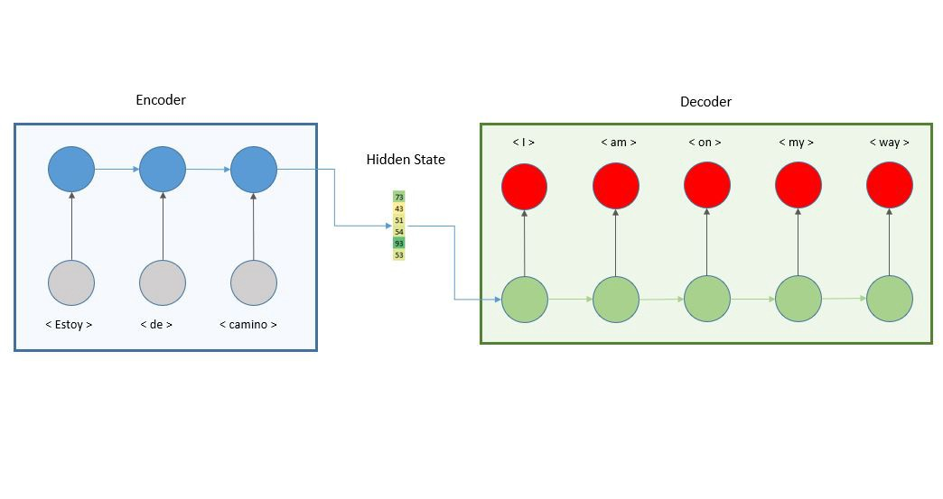
Model Architecture
Structure of encoder-decoder

Slide 5
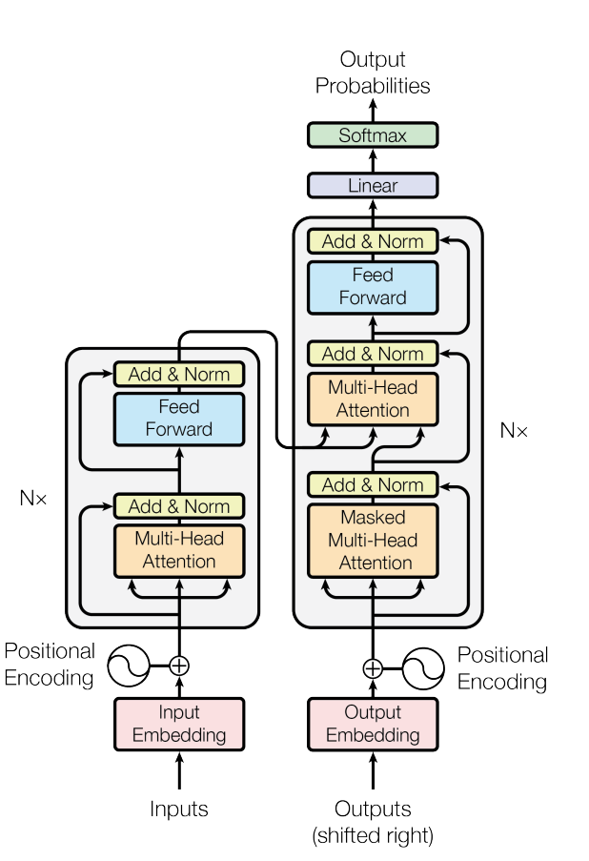
Transformer

Slide 6
Detail of architect
Attention: mapping a query and a set of key-value pairs to an output in vector form.

Slide 7

Detail of architect
Scaled dot-product attention

